Slide 1
Character set :
A character set can also be called a coded character set, a code set, a code page, or an encoding. Examples of character sets include International EBCDIC (Extended Binary Coded Decimal Interchange Code ).
There are three different Unicode character encodings: UTF-8, UTF-16 and UTF-32.
This is “UTF”, or “Unicode Transformation Format.”. It can translate any Unicode character to a matching unique binary string, and can also translate the binary string back to a Unicode character. It provides 3 types of encodings.
UTF-8 − It comes in 8-bit units.
UTF-16 − It comes in 16-bit units.
UTF-32 − It comes in 32-bit units.
The maximum number of characters that can be represented in extended ASCII is 256. As an example, the ASCII code for uppercase A is 65.
A character set is an element of internationalization that maps and translates an alphabet; that is, the characters that are used in a particular language. A character set is made up of a series of code points, or the numeric representation of a character. A character set can also be called a coded character set, a code set, a code page, or an encoding. Examples of character sets include International EBCDIC, Latin 1, and Unicode. Character sets are chosen on the basis of the letters and symbols required.

Slide 2
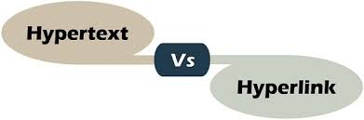
Hypertext
Hypertext is text which is not constrained to be linear. Hypertext is text which contains links to other texts. The term was coined by Ted Nelson around 1965 (see History ). Hyper Media is a term used for hypertext which is not constrained to be text: it can include graphics, video and sound.
Hyper Text Markup Language (HTML) is the basic scripting language used by web browsers to render pages on the world wide web. Hyper Text allows a user to click a link and be redirected to a new page referenced by that link.
Apart from text, the term "hypertext" is also sometimes used to describe tables, images, and other presentational content formats with integrated hyperlinks.

Slide 3
Hypertext
In Hyperlinks the references are used in the hypertext or with other hypermedia. Hypertext involves only text. Hyperlink involves Text, media, audio, video, images, and graphics.
Text Hyperlink
Image Hyperlink
Video Hyperlink
Graphic Hyperlink
Graphics Hyperlink

Slide 4
Digital fonts
A computer font is implemented as a digital data file containing a set of graphically related glyphs. A computer font is designed and created using a font editor.
What are four main types of fonts?
Serif fonts
Times New Roman
Garamond
Georgia).
Sans serif fonts
Arial
Futura
Helvetica
Script fonts
Courier 12.
Display fonts(“Display” means type intended for large sizes)
Brandon Grotesque.
Bourton.
Spock.
Sofa Serif – 25 Hand Drawn Display Fonts.
Highbinder Display Font.
Gilroy.
Requiem Display Font.
Sugar Boats Display Font.

Slide 5
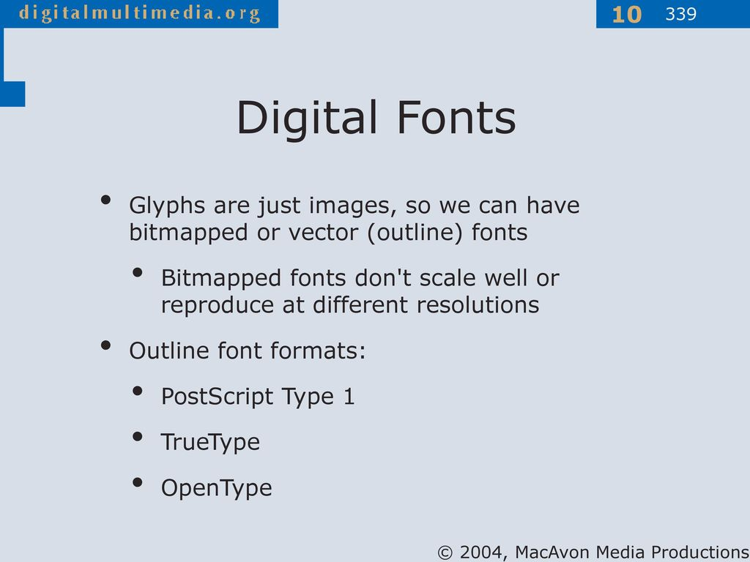

Slide 6
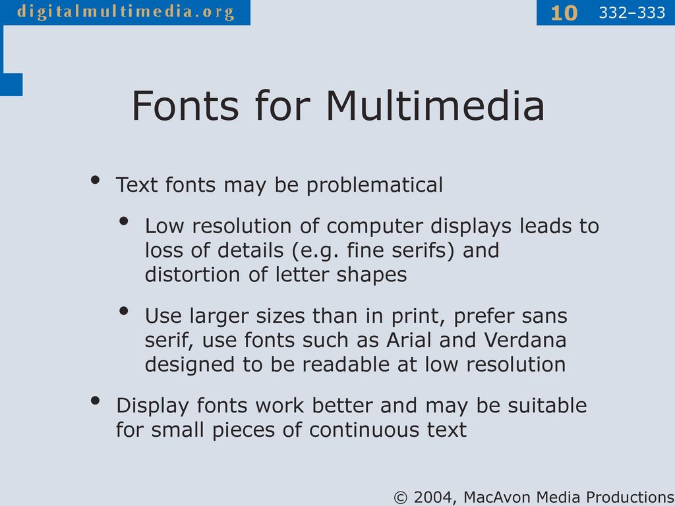

Slide 7
Character set :-
The character set definition defaults that are on the z/TPF system support all aliases for the character sets that are supported on the GNU C library (glibc). Not all glibc translations are included on the z/TPF system.
The z/TPF system supports multibyte character sets that use shift-out and shift-in (shift out of a regular character set mode; shift back to regular character set mode). Wide characters are 4 bytes and encoded using the UCS-4 character set, which is a Unicode-based character set and ASCII compatible. For more information about multibyte character sets and wide characters.

Slide 8
International Hypertext
Hypertext refers to links among textual items, often indicated on a computer or website by key words set in underlined blue type, that, when highlighted by a pointer device (e.g. mouse, trackball, finger on a touch-sensitive screen) and selected or clicked, take the reader to the referent. These links are usually defined in terms of their activity and are referred to as hotlinks or hyperlinks or, increasingly commonly, simply links. The referent of the hyperlink might be a separate screen or so-called ‘page’ that obscures or replaces the first page, or simply a small box of text that appears to float above the initial page.

Slide 9
For example, in a language-learning program, one might click on a hypertext link to go to one of several choices in a branching story and arrive at that link on another page, or simply click on a word to get a floating box offering its dictionary definition. Hypertext is often used to link text to materials traditionally contained in footnotes and annotations but may also include much more. Bolter (1991) explains the significance of hypertext: ‘Electronic text is the first text in which the elements of meaning, of structure, and of visual display are fundamentally unstable’ (p. 31). By this he means that electronic texts are subject to rearrangement and reordering by the user beyond the traditional linear organization of books.

Slide 10
This has countless implications to the creation of language-learning materials where the sequence of learning is so often strictly predetermined, based on research as to the order of complexity of lexical items and structures. Computer Assisted Language Learning (ENG517) VU ©Copyright Virtual University of Pakistan 3 J.D. Bolter on footnotes: In a printed book, it would be intolerably pedantic to write footnotes to footnotes. But in the computer, writing in layers is quite natural, and reading in layers is effortless.

Slide 11
All the individual paragraphs may be of equal importance in the whole text, which then becomes a network of interconnected writings. The network is designed by the author to be explored by the reader in precisely this peripatetic fashion. Bolter (1991: 15) The development of hypertext has been associated most closely with a constructivist model of learning and aspects of schema theory.

Slide 12
But while the behaviourist model might use hypertext’s special features only to link text with explanations, tests and answers, the constructivist model might consider the same features and use them to encourage learners to evaluate the structure and the sequence of their own learning. This latter approach is more likely to accommodate collaboration and negotiation of meaning as it involves a greater degree of decision-making.

Slide 13
Any query ??

Slide 14

Thank you

